Slide 1
Pseudo-Goodwin cycles in a Minsky model
E Stockhammer & J Michell

Slide 2
Main idea
Goodwin cycle: profit-led demand + reserve army effect => counter-clockwise movement of output and wage share
This paper: the existence of a counter clockwise movement of output and the wage share is not a sufficient condition for the existence of Goodwin cycle
Pseudo-Goodwin cycle: a counter-clockwise movement of output and wage share without a Goodwin mechanism = something that looks like a Goodwin cycle, but isn’t
simple Minsky-type model. We add a distribution adjustment a la Goodwin. In this model the cycle is generated from the interaction of debt (financial fragility) and demand. Income distribution preys on demand, but it has not feedback. By design, demand does not react to changes in income distribution. However, the model does exhibit a pseudo Goodwin cycle in the output-wage share space.

Slide 3
Outline
Why it matters
Goodwin cycle (model)
A simple Minsky model (M1)
A Minsky model with a reserve army effect (M2)
Extending the model for small wage-led demand effect (M3)
Conclusion

Slide 4
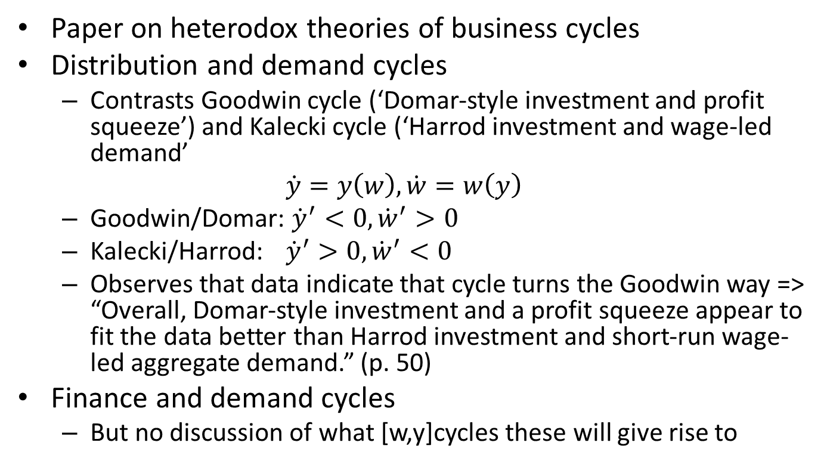
Taylor (2012)
Paper on heterodox theories of business cycles
Distribution and demand cycles
  Contrasts Goodwin cycle (‘Domar-style investment and profit squeeze’) and Kalecki cycle (‘Harrod investment and wage-led demand’
  $\dot{y}=y\left(w\right), \dot{w}=w\left(y\right)$
  Goodwin/Domar: ${\dot{y}}^{′}<0, {\dot{w}}^{′}>0$
  Kalecki/Harrod: ${\dot{y}}^{′}>0, {\dot{w}}^{′}<0$
  Observes that data indicate that cycle turns the Goodwin way => “Overall, Domar-style investment and a profit squeeze appear to fit the data better than Harrod investment and short-run wage-led aggregate demand.” (p. 50)
Finance and demand cycles
  But no discussion of what [w,y]cycles these will give rise to

Slide 5
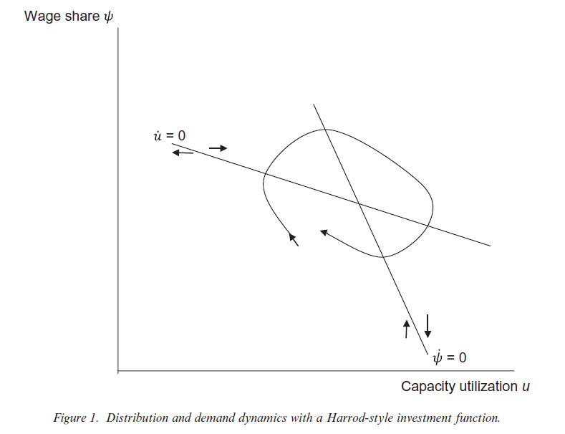
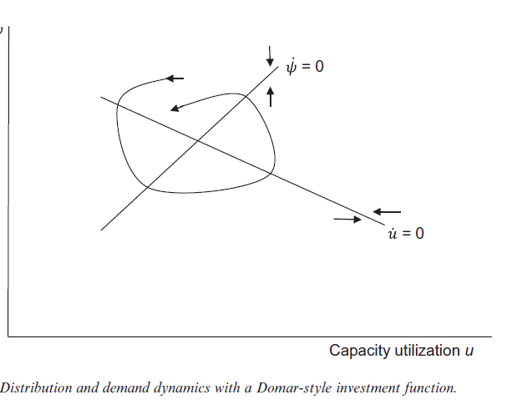
Profit squeeze cycles vs wage-led cycles
Taylor (2012) calls these investment a la Domar(profit squeeze cycles vs investment a la Harrod (wage-led cycles
Diallo et al (2011) use ‘profit and labour market led’ vs ‘wage and good market led’ cycles

Slide 6
Pseudo-Goodwin cycle
Pseudo Goodwin cycle: it looks like a Goodwin cycle, but it isn’t
Goodwin cycle: profit-led demand and Marxian distribution function -> counter-clockwise cycle in wage share-output space
Pseudo Goodwin cycle: counter-clockwise cycle in wage share-output space that is not due to Goodwin mechanism,
In particular: not related to profit-led demand

Slide 7
Goodwin model
demand
Distribution
Wage share
Finance
+
-

Slide 8
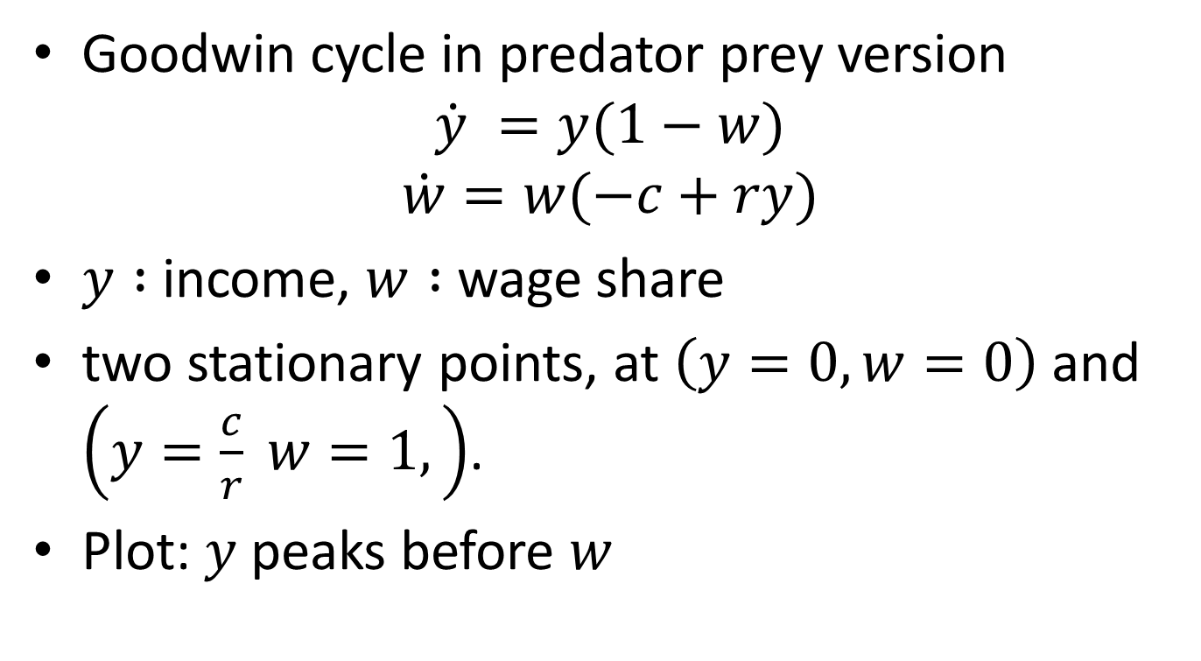
Goodwin cycle
Goodwin cycle in predator prey version
$$\dot{y} =y(1−w)$$
$$\dot{w}=w(−c+ry)$$
$y :$ income, $w :$ wage share
two stationary points, at $\left(y=0,w=0\right)$ and $\left(y=\frac{c}{r} w=1,\right)$.
Plot: $y$ peaks before $w$

Slide 9
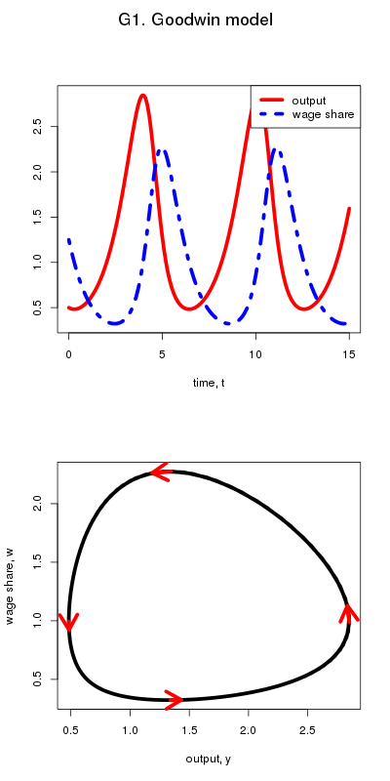

Slide 10
Empirical literature on Goodwin cycles (and profit/wage-led demand)
 | Methodological approach
 | Identifying cycle: which direction does it turn? In which order | Identify behavioural equation for investment and consumption
Marxist debate: profit squeeze theory vs. underconsumptionists | Sherman (1997), van Lear (1999), Goldstein (1999), Harvie (2000)
Marxists – Post Keynesians/Kaleckians : profit led demand vs. wage-led demand | Diallo et al (2011), Taylor (2012) Barbosa-Filho & Taylor (2006), Proano et al (2011) Bowles & Boyer (1995), Stockhammer & Onaran (2004), Naastepad & Stoorm (2006), Hein & Vogel (2008), Stockhammer & Stehrer (2011)

Slide 11
Goodwin and PK Economics
Heterodox economists agree that distribution matters for demand. But they disagree on the sign of the effect
Goodwin / Marx: profit share ↑ → investment ↑ → demand↑ („profit-led demand“)
  Goodwin cycle: profit share ↑ → investment ↑ → growth ↑ → employment ↑ → profit share ↓ → investment ↓ → …
Kalecki / Post Keynesians: profit share ↑ → consumption ↓ → demand↓ („wage-led demand“)
  „Kaleckian“ cycle: profit share ↑ → consumption ↓ → demand↓ →investment ↓ → growth ↓ → employment ↓ → : profit share ↓
Agreement: dC/dWS > 0 and dI/dWS < 0
  Goodwin: effect of wage share on investment is direct → growth increases.
  Kalecki: effect of wage share on consumption is larger than effect on investment → profit rate falls → growth falls.
PKs posit wage-led demand, but don‘t derive business cycle theory from that rather BC results from finance-demand interaction (Minsky) or demand-capacity interactions (Kalecki)

Slide 12
Minsky model
Minsky gives narrative discussion of cycle mechanism -> a substantial lit trying to model Minsky cycles
Minsky suggests endogenous cycle in fragility and output:
  Higher output leads to higher fragility (endogenous shift to more fragile financial structure as expansions are debt financed)
  Higher fragility leads to lower output
Charles (2008), Fazzari et al (2008) and Asada (2001) relevant models. They differ substantially in the details of the model
  Charles (2008) debt → higher interest
  Fazzari et al (2008) growth → inflation → higher interest
  Asada (2001): unstable (Kaldorian) goods market
  Lavoie and Seccareccia (2001) argue that debt need not increase during the boom – not our concern here.
Our stylized Minsky model does not go into detail, but in principle consistent with these Minsky cycle models

Slide 13
Model Minsky (M1)
demand
Finance
financial fragility
distribution
-
+

Slide 14
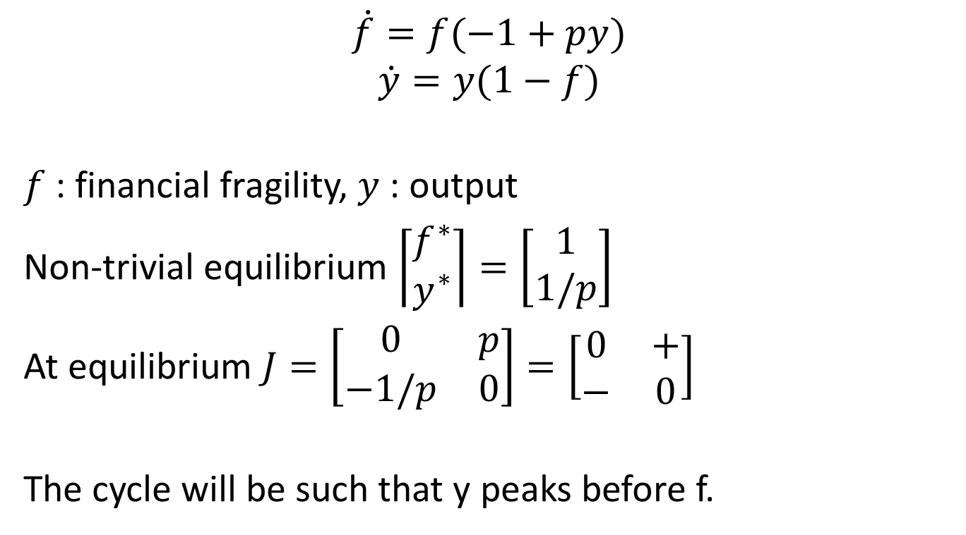
Minsky cycle (M1)
$$\dot{f}=f(−1+py)$$
$$\dot{y}=y(1−f)$$
$f$: financial fragility, $y$: output
Non-trivial equilibrium $\left\lceil \begin{matrix}f^{∗} \\ y^{∗}\end{matrix}\right\rceil =\left[\begin{matrix}1 \\ 1/p\end{matrix}\right]$
At equilibrium $J=\left[\begin{matrix}0 & p \\ −1/p & 0\end{matrix}\right]=\left[\begin{matrix}0 & + \\ − & 0\end{matrix}\right]$
The cycle will be such that y peaks before f.

Slide 15
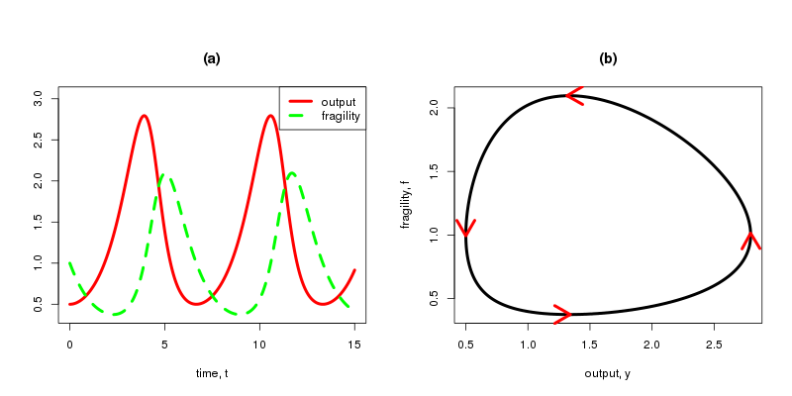
Minsky Model (M1)

Slide 16
M2: Minsky model with reserve army
demand
Finance
Financial fragility
Distribution
Wage share
-
+
+

Slide 17
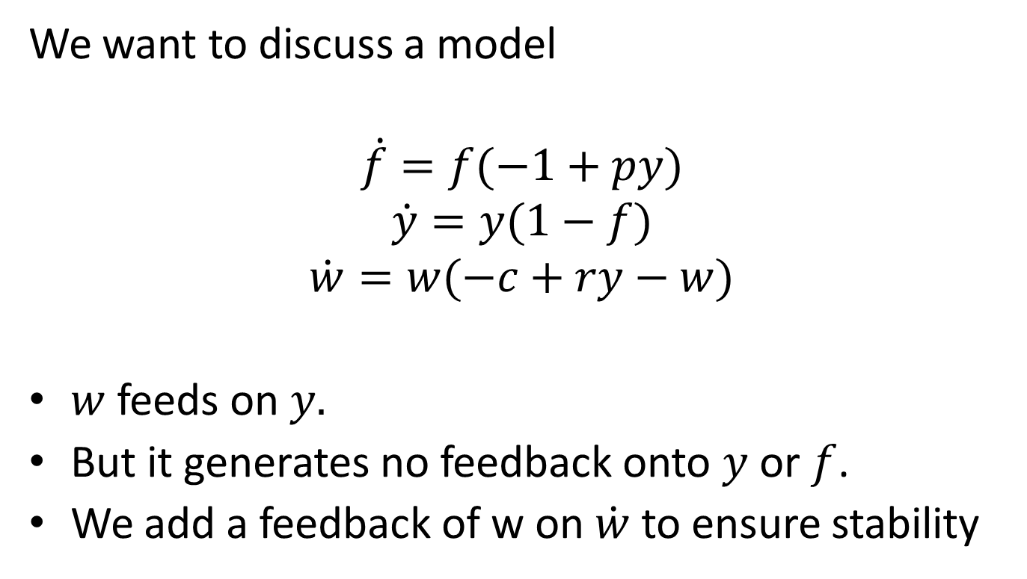
Minsky model with reserve army effect (M2)
We want to discuss a model
$$\dot{f}=f(−1+py)$$
$$\dot{y}=y(1−f)$$
$$\dot{w}=w(−c+ry−w)$$
$w$ feeds on $y.$
But it generates no feedback onto $y$ or $f$.
We add a feedback of w on $\dot{w}$ to ensure stability

Slide 18
Role of wage share
Model closely related to ‘predator-prey model with scavenger’ in biology (Chauvet et al 2002, Nolting et al 2008)
More accurately: real wage is a harmless parasite.
It feeds on higher output but causes no harm
Real wage is also has ‘self-regulating’ element
Model thus different from Keen (1995) -- he models economies with Minsky as well as Goodwin cycles.

Slide 19
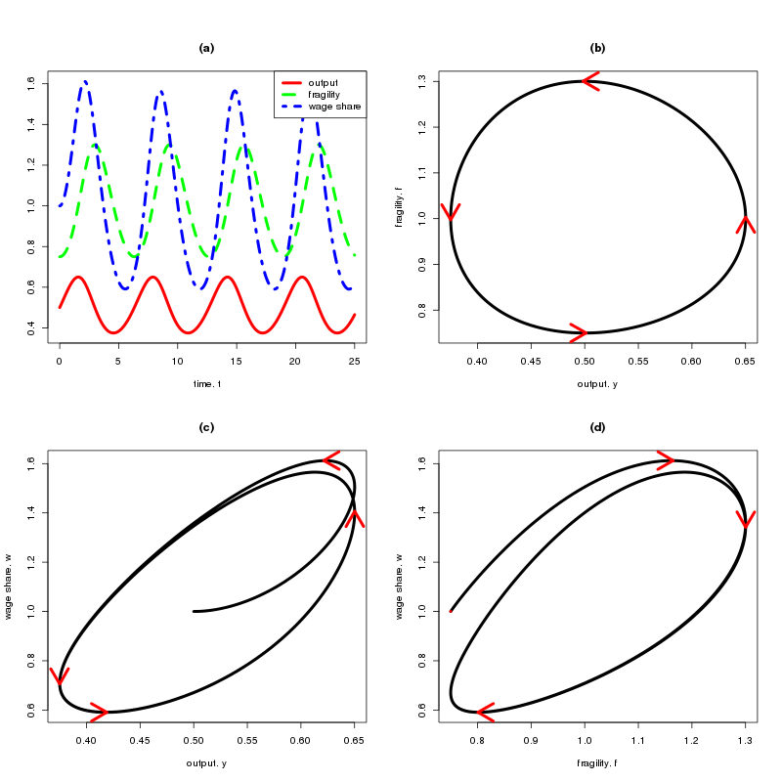

Slide 20

M3: Minsky model with reserve army effect and wage-led demand effect
demand
finance
distribution
-
+
+
+

Slide 21
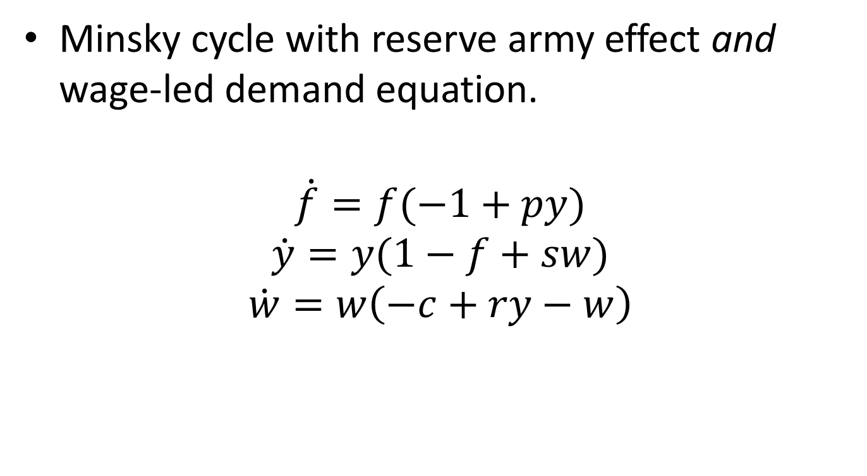
Model M3: Pseudo-Goodin model with wage-led demand effect
Minsky cycle with reserve army effect and wage-led demand equation.
$$\dot{f}=f(−1+py)$$
$$\dot{y}=y(1−f+sw)$$
$$\dot{w}=w\left(−c+ry−w\right)$$

Slide 22
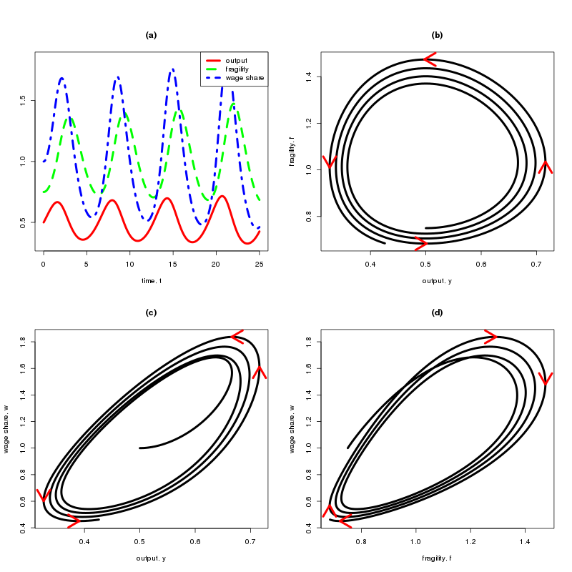

Slide 23
Summary
The existence of a counter-clockwise movement in output-wage share space is not proof of the existence of a Goodwin cycle.
Pseudo-Goodwin cycles: look like Goodwin cycle, but are not generated by Goodwin mechanism.
A Minsky model with reserve army effect (M2), but without profit-led demand can give rise to pseudo-Goodwin cycles.
A Minsky model with reserve army effect and wage-led demand (M3) can also generate (unstable) pseudo-Goodwin cycles.

Slide 24
Conclusion
Taylor (2012), Diallo et al (2011) interpret counter-clockwise movement of in output-wage share space as evidence for Goodwin cycles and, by implication, for a profit-led demand regime.
This is incorrect.
Pseudo-Goodwin cycles can arise independent of profit-led demand; and they can also arise in wage-led demand regime.
Extension: A wide range of business cycle models will give pseudo Goodwin cycle if there is a reserve army distribution function
Positively put, for the type of models we have analysed: counter-clockwise movement of in output-wage share space is evidence for a reserve army-type distribution function, but not for profit-led demand.

Slide 25
Appendix
We have assumed that wage share eqn contains self-stabilising mechanism
If relax this assumption this, we get modified results:
  If wage-share eqn is linear combination of fragility equation, closed orbits in all pairs of variables.
  If not linear combination, no closed orbits, but instead explosive or implosive oscillations in w.
  But still a (decaying) pseudo-Goodwin cycle.

Slide 26
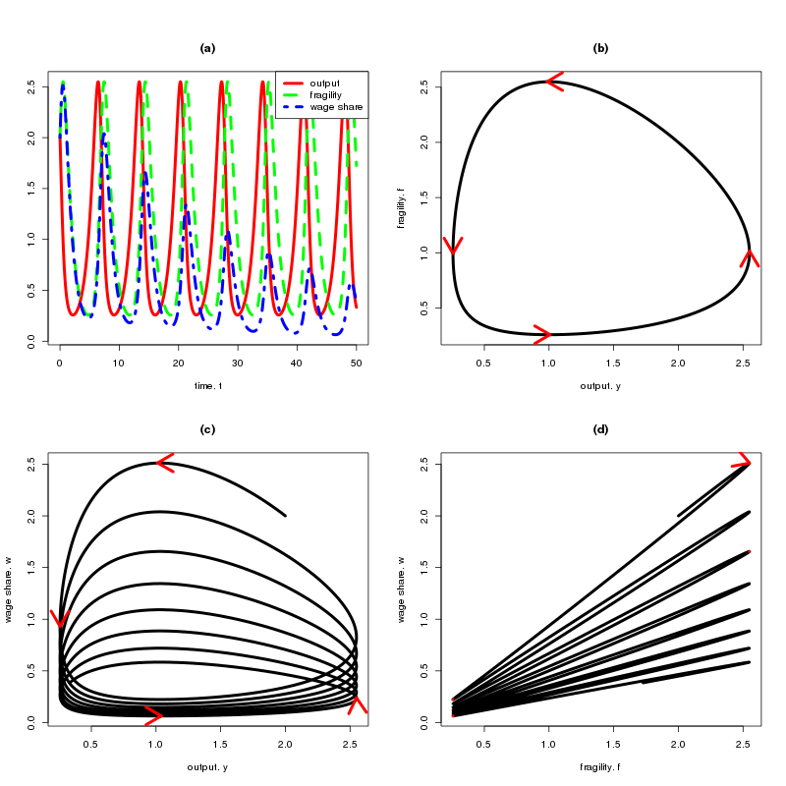

Slide 27
Empirical lit
Goldstein (1999) estimates a two equation VAR with unemployment and the profit share, but the results cannot be interpreted as demand functions.
Harvie (2000) follows Goodwin in assuming that all profits get automatically reinvested. Consequently there is no demand side to be estimated, but only various components of the distribution side.
Mohun and Veneziani’s (2007) contribution lies in the careful discussion of the definition of profits and wages. They aim to identify the cycle and its forces by providing a discussion of plots of HP-filtered data, but no econometric analysis of the relevant behavioral equations is undertaken.
Barbosa-Filho and Taylor (2006) estimate a two equation VAR with a demand equation and a distribution equation (without contemporaneous interaction) for the US economy using quarterly data and the cyclical component of the HP filter. The effects for individual components of demand are then decomposed from the aggregate results (rather than estimated as behavioral equations). This gives strong perverse results in the consumption function. The (negative) effect of an increase in the wage share on consumption is larger than those on investment and net exports combined. They conclude that the US economy is in a profit-led demand regime.
  Stockhammer and Stehrer (2011) note that the results based on the HP filed are suffering from serious autcorrelation problems and the results are not robust with respect to the lag length.
Contrast to Kaleckian wage-led lit
Stockhammer & Stehrer argue that the existing Goodwin lit has paid insufficient attention to the demand side. In particular it has failed to present convincing evidence that profits react substantially to profits.

